Slide 1





Detection of Cyber Attack in Network
using Machine Learning Techniques
Group 15
Guide:- Neha Lahane

Slide 2

Topic
Being able to identify cyber attacks in a network is vital and machine learning techniques have nicely worked out in this area. The usage of machine learning for computing purpose is so significant because it can analyze huge amounts of data for a pattern, to be able to draw some pretty good conclusions, or for taking a factor in the real-time process of, that would be the better choice of approach. As a result, companies are able to quickly address probable threats and avoid attacks.
Dataset
Among these datasets some are generated with only one or two types of attacks, which are due to the lack of filesystem diversity and volume, some others do not contain a large set of known attacks and still, some of them (false traffic data) are not relevant to real-world data. While others also miss a feature set and metadata.

Slide 3


Abstract
The input text presents a formal, concise summary of a study on the application of machine learning techniques to detect cyber attacks in network-based systems. The tone is academic and informative, with a focus on the effectiveness of different machine learning algorithms. The content is structured logically, first addressing the problem of traditional intrusion detection systems, then introducing machine learning as a solution, and finally mentioning the evaluation of these algorithms using a specific dataset.
DDos.csv dataset is composed of good data (benign flows and the most common attacks) which are very similar to real world data (PCAPS). The dataset systematically appends information generated from the flow of network traffic and offers the labeled traffic based on the time stamp, the source and destination IPs, source and destination ports, protocols and attack (CSV files). Also available is the NetFlowMeter. The NetFlowMeter is capable of providing some real-time and historical data like IP, port, and flow which can be very useful for traffic analysis (tar.gz files).
Among these datasets some are generated with only one or two types of attacks, which are due to the lack of filesystem diversity and volume, some others do not contain a large set of known attacks and still, some of them (false traffic data) are not relevant to real-world data. While others also miss a feature set and metadata.

Slide 4

SRS
The Software Requirement Specification (SRS) document outlines the development of a system to detect cyber attacks using machine learning. It details the system's purpose, scope, functional and non-functional requirements, user interfaces, and deliverables. The system will monitor network traffic in real-time, detect anomalies, and generate alerts and reports, ensuring enhanced network security.
FRS
The document is a Functional Requirement Specification (FRS) for a project aimed at detecting cyber-attacks using machine learning techniques. It outlines the purpose, background, and scope of the project, focusing on using algorithms like artificial neural networks and random forests to identify and prevent cyber threats. The document details functionalities, including data ingestion, preprocessing, model development, real-time detection, and integration with existing systems, ensuring enhanced cybersecurity through automated detection and actionable insights.

Slide 5

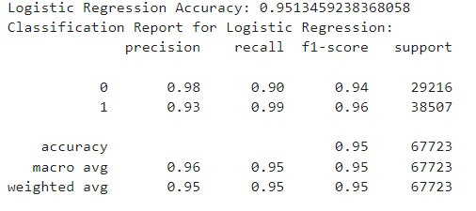
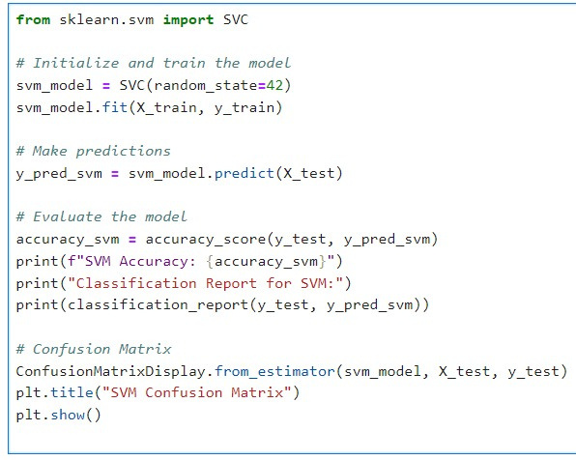
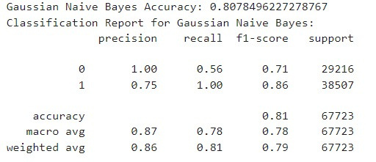
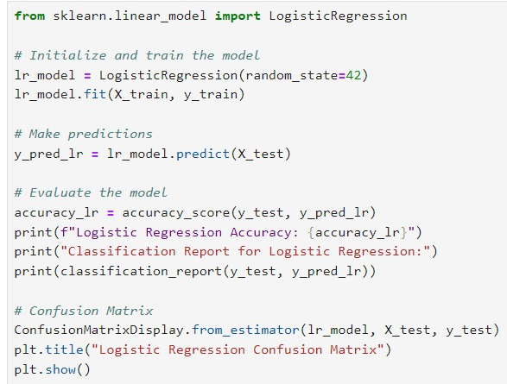
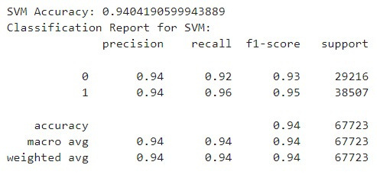
About Code
Accuracy

Slide 6
Future Scope
The future scope of detection of cyber attacks in networks using machine learning techniques is vast and promising. With the increasing complexity of cyber threats, machine learning algorithms can play a crucial role in detecting and preventing these attacks. The use of machine learning techniques can improvethe accuracy and efficiency of cyber attack detection systems.
Some potential future work could include designing adaptive algorithms that can evolve with emerging cyber threats and update their models accordingly. This can ensure long-term effectiveness in cyber threat detection without the need for frequent retraining or manual adjustments.
Additionally, the integration of machine learning with other technologies such as IoT, cloud computing, and big data analytics can further enhance the capabilities of cyber attack detection systems.
The potential applications of machine learning in cyber attack detection are numerous, including:
Anomaly detection: Machine learning algorithms can be trained to identify unusual patterns in network traffic that may indicate a cyber attack.
Predictive analytics: Machine learning models can be used to predict the likelihood of a cyber attack based on historical data and other factors.
Incident response: Machine learning algorithms can help automate the incident response process by identifying the source and scope of a cyber attack.
Overall, the future of cyber attack detection using machine learning techniques is promising, and ongoing research and development in this area can lead to more effective and efficient detection systems.

Slide 7

Thank You
Team Members
Piyush Shende :- 240350125050
Pranshu Mishra :- 240350125053
Vedang Jadhav :- 240350125068
Utkarsha Payghan :- 240350125049

